Slide 1
Data Structures ICT-1211 Information and Communication Technology
Lecture-03
Date:

Slide 2
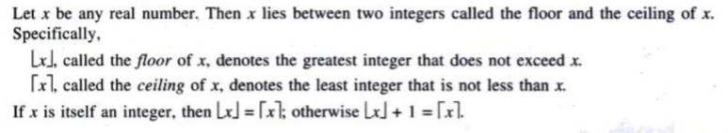
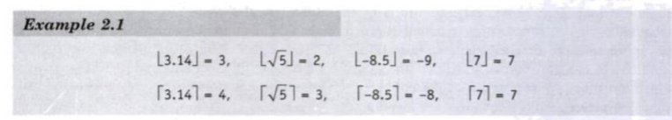
Mathematical Notation & Function
Floor and Ceiling Function

Slide 3
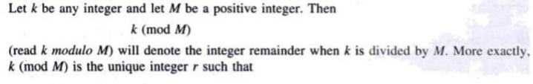
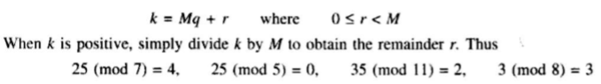
Mathematical Notation & Function
Remainder Function; Modular Arithmetic

Slide 4
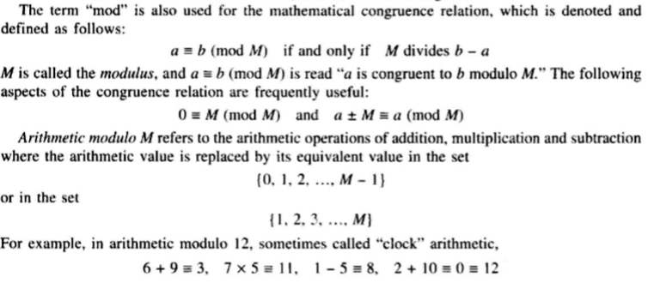
Mathematical Notation & Function
Remainder Function; Modular Arithmetic

Slide 5
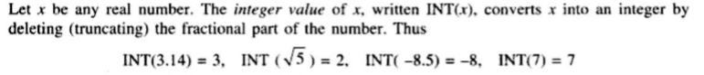
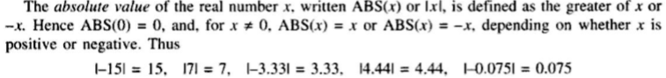
Mathematical Notation & Function
Integer and Absolute Value Functions

Slide 6
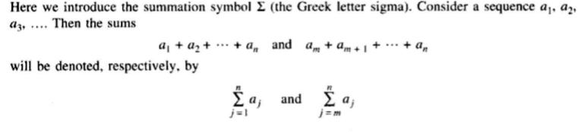
Mathematical Notation & Function
Summation Symbol; Sums

Slide 7
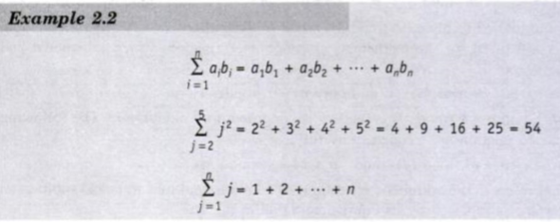
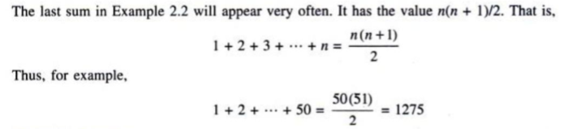
Mathematical Notation & Function
Summation Symbol; Sums

Slide 8
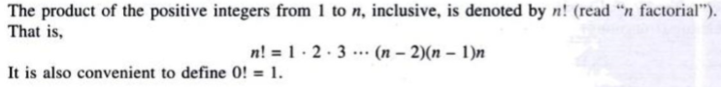
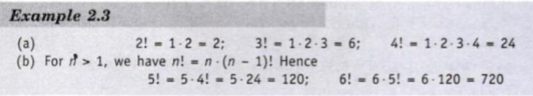
Mathematical Notation & Function
Factorial Function

Slide 9
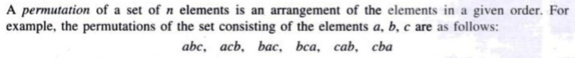
Mathematical Notation & Function
Permutations

Slide 10
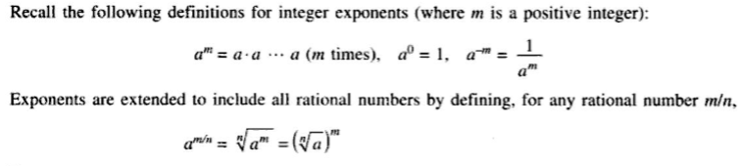
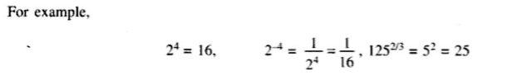
Mathematical Notation & Function
Exponents and Logarithms

Slide 11
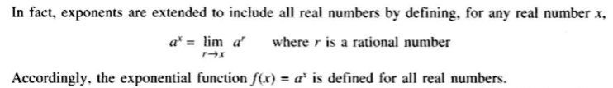
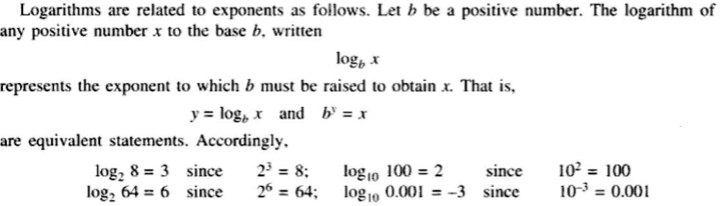
Mathematical Notation & Function
Exponents and Logarithms

Slide 12
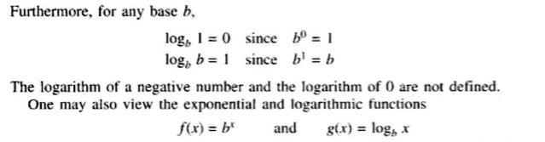
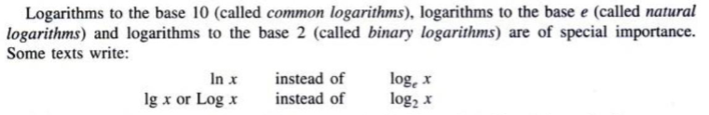
Mathematical Notation & Function
Exponents and Logarithms

Slide 13
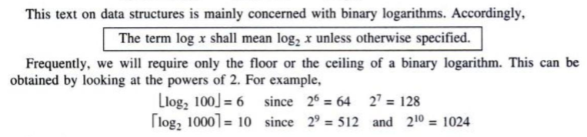
Mathematical Notation & Function
Exponents and Logarithms

Slide 14
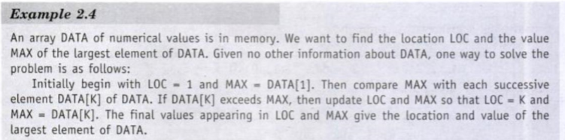
Algorithmic Notation

Slide 15
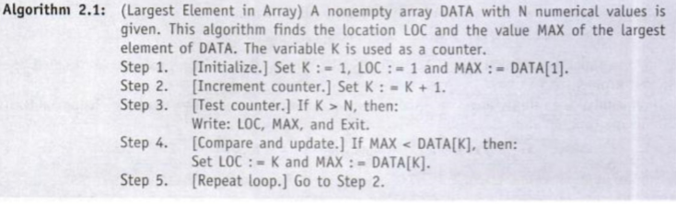
Algorithmic Notation

Slide 16
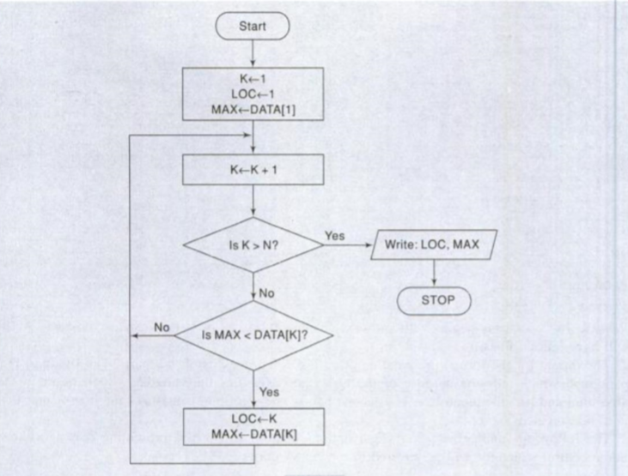
Algorithmic Notation

Slide 17
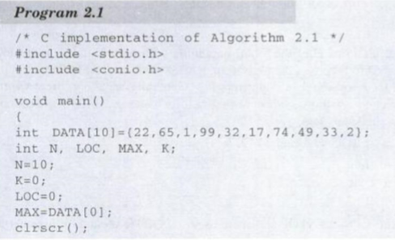
Algorithmic Notation
Program implementation:

Slide 18
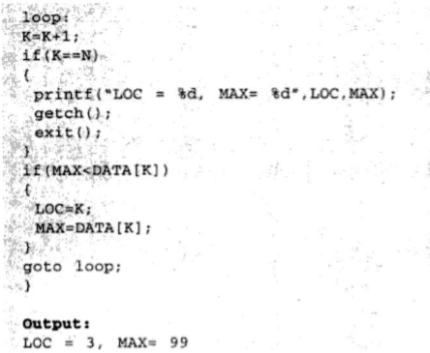
Algorithmic Notation
Program implementation:

Slide 19
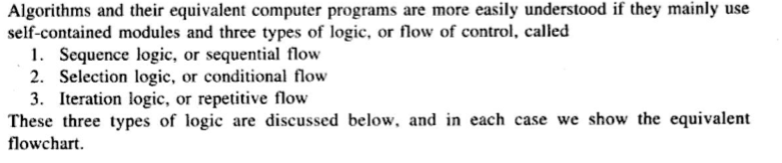
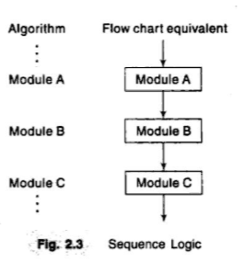
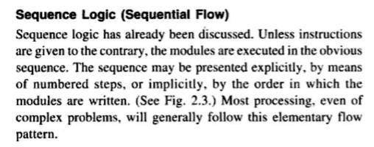
Control Structures

Slide 20
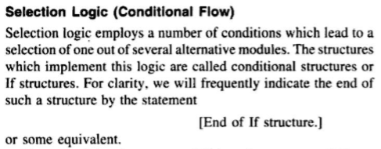
Control Structures

Slide 21
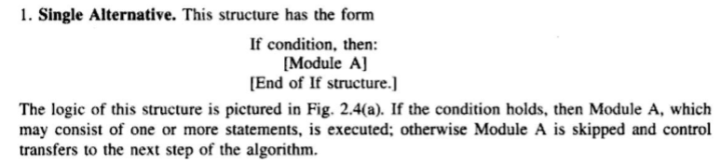
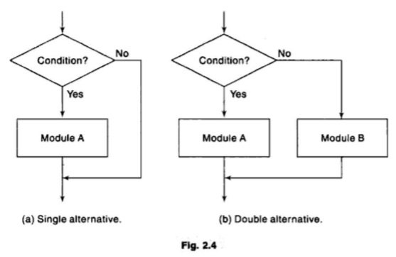
Control Structures

Slide 22
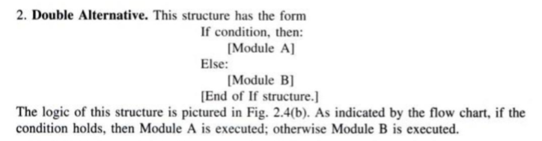
Control Structures

Slide 23
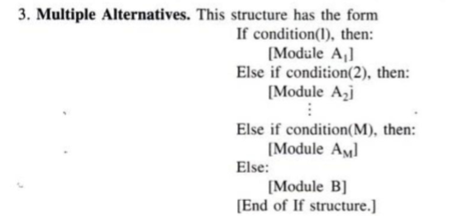
Control Structures

Slide 24
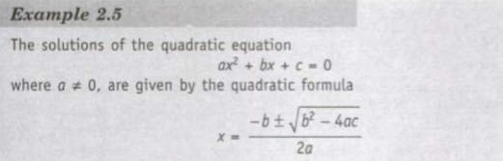
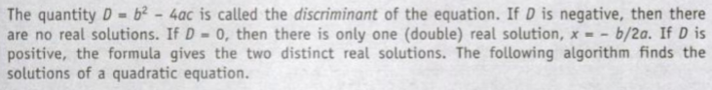
Control Structures

Slide 25
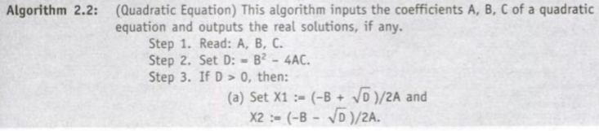
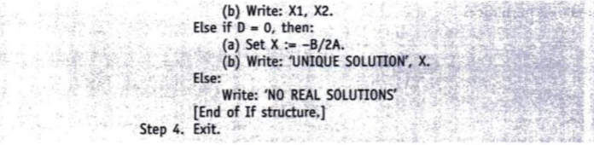
Control Structures

Slide 26
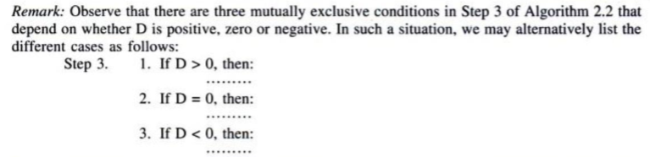
Control Structures

Slide 27
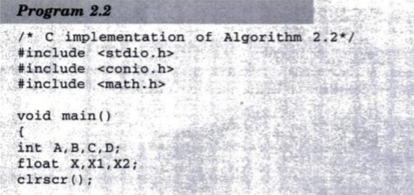
Control Structures
Program implementation

Slide 28
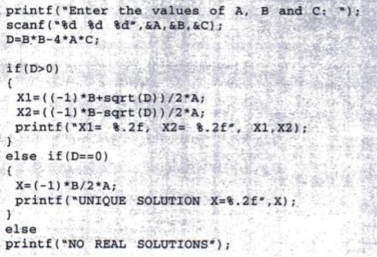
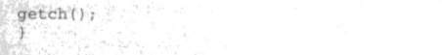
Control Structures
Program implementation

Slide 29
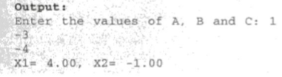
Control Structures
Program implementation

Slide 30
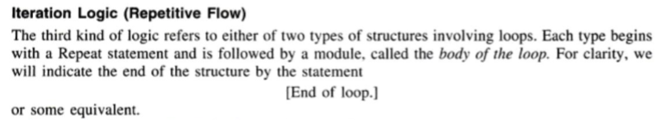
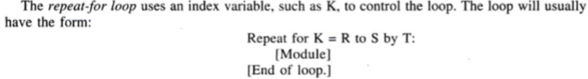
Control Structures

Slide 31
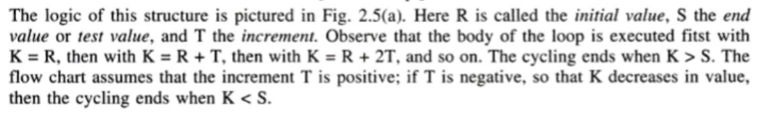
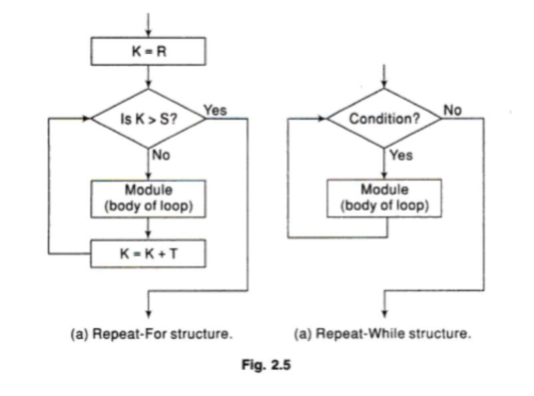
Control Structures

Slide 32
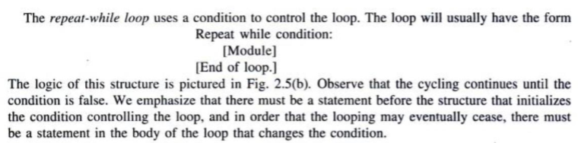
Control Structures

Slide 33
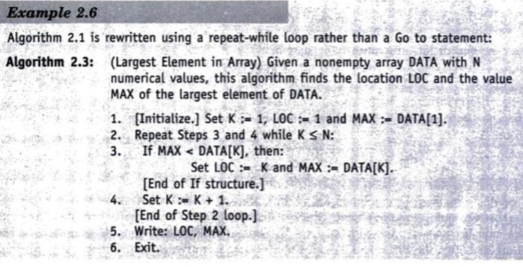
Control Structures

Slide 34
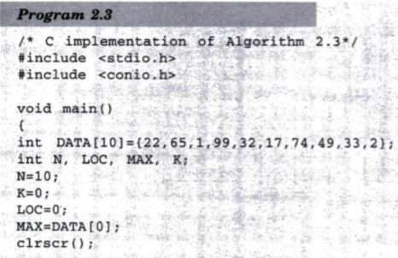
Control Structures
Program Implementation

Slide 35
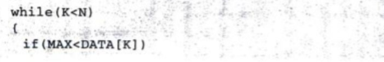

Control Structures
Program Implementation

Slide 36


Complexity of Algorithms

Slide 37


Complexity of Algorithms

Slide 38

Complexity of Algorithms

Slide 39

Complexity of Algorithms

Slide 40


Complexity of Algorithms
Program implementation

Slide 41

Complexity of Algorithms
Program implementation

Slide 42

Complexity of Algorithms

Slide 43

Complexity of Algorithms

Slide 44


Rate of growth; Big O Notation

Slide 45


Rate of growth; Big O Notation

Slide 46
Thank you……

